Slide 1
Week 11 Q&A
簡廷因 Ting-Ying Chien
2015.11.30

Slide 2
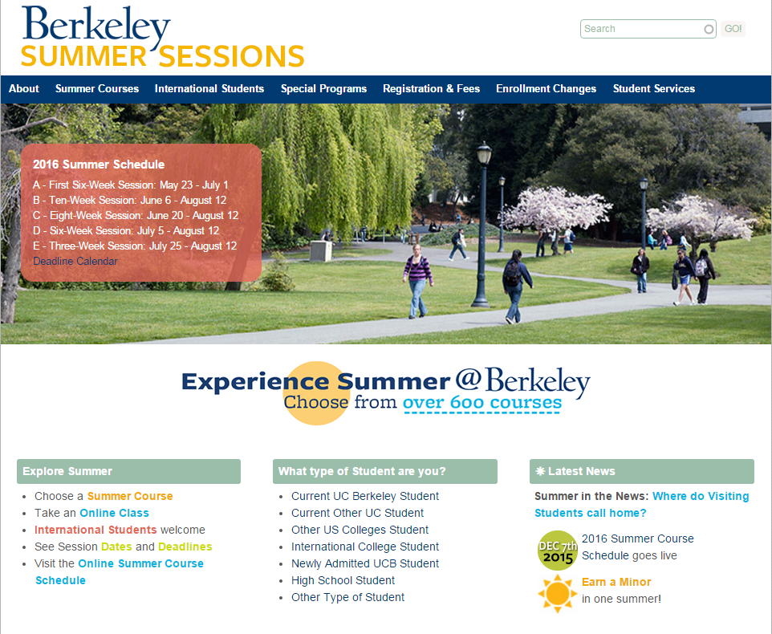
FYI
Berkeley Summer Session
http://summer.berkeley.edu/

Slide 3
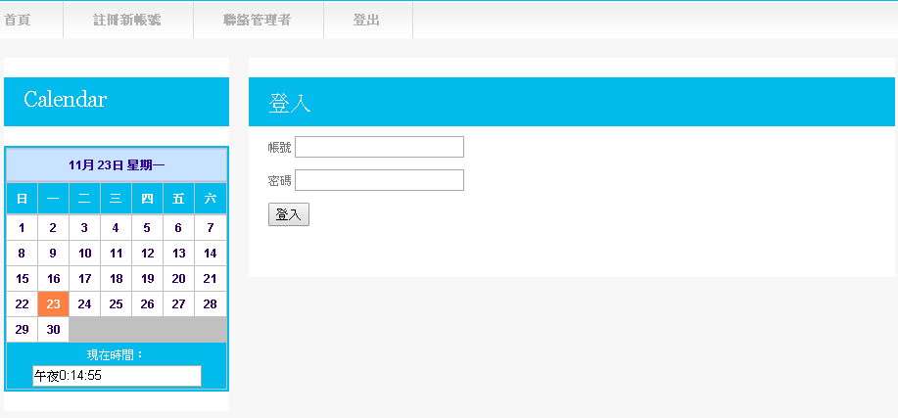
Q1: Homework3 test
http://yzu.csie.org/tinin/1041web/index.html
帳密 : s+學號

Slide 4
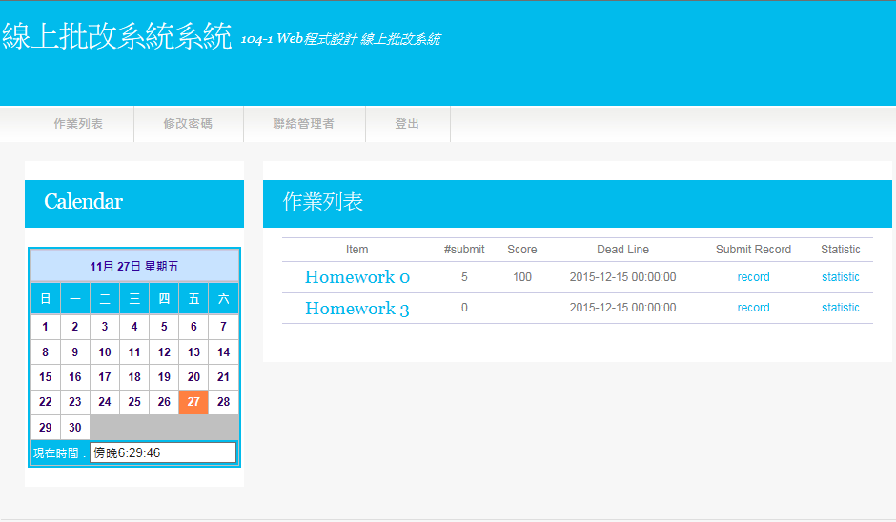
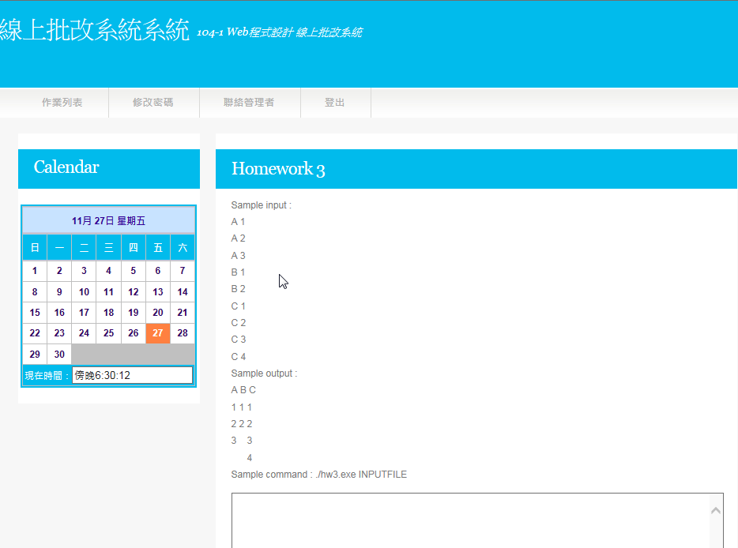
Q1: Homework3 test
Submit your code

Slide 5
Q1: Homework3 test
int main(int argc, char *argv[]) {
string tmp;
char *pch;
char input[100][2];
int i=0,j=0;
fstream infile(argv[1],ios::in);
while(!infile.eof())
{
getline(infile,tmp);
j=0;
for(pch=strtok((char*)tmp.c_str()," "); pch; pch=strtok(NULL,","))
{
input[i][j]=*pch;
j++;
}
i++;
}
infile.close();
// YOUR CODE START
// YOUR CODE END
}

Slide 6
Q2 : Homework 3
批改系統都是0
傳值有問題
Logical error
Output 格式錯誤
system("pause") 請刪除
批改系統分數沒100
Logical error
尚未考慮部份情況
C++ library 不同

Slide 7
Q2 : Homework 3
Javascript
不知如何從C++ -> Javascript
可參考ppt
Output不會顯示
請先用chrome幫忙debug

Slide 8
Q2 : Homework 3
測資提供
mailto : tinin@saturn.yzu.edu.tw
deadline
12/15 23:59

Slide 9
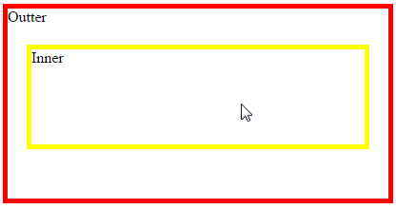
Q3 : UseCapture
<!DOCTYPE html>
<html>
<head>
<meta charset = "utf-8">
<title>useCapture</title>
<style type = "text/css">
div#outdiv
{
border: 5px solid red;
height : 200px;
width : 400px;
}
div#indiv
{
margin : 20px;
border: 5px solid yellow;
height : 100px;
width : 350px;
}
</style>
<script>
function start()
{
var outdiv = document.getElementById("outdiv");
outdiv.addEventListener("click",outfun,false);
var indiv = document.getElementById("indiv");
indiv.addEventListener("click",infun,false);
}
function outfun()
{
alert("Out");
}
function infun()
{
alert("In");
}
window.addEventListener( "load", start, false );
</script>
</head>
<body>
<div id="outdiv">Outter<div id="indiv">Inner</div></div>
</body>
</html>
In -> Out

Slide 10
Q3 : UseCapture
<!DOCTYPE html>
<html>
<head>
<meta charset = "utf-8">
<title>useCapture</title>
<style type = "text/css">
div#outdiv
{
border: 5px solid red;
height : 200px;
width : 400px;
}
div#indiv
{
margin : 20px;
border: 5px solid yellow;
height : 100px;
width : 350px;
}
</style>
<script>
function start()
{
var outdiv = document.getElementById("outdiv");
outdiv.addEventListener("click",outfun,true);
var indiv = document.getElementById("indiv");
indiv.addEventListener("click",infun,true);
}
function outfun()
{
alert("Out");
}
function infun()
{
alert("In");
}
window.addEventListener( "load", start, false );
</script>
</head>
<body>
<div id="outdiv">Outter<div id="indiv">Inner</div></div>
</body>
</html>
Out -> In

